Slide 1
MOSPF and PIM

Slide 2
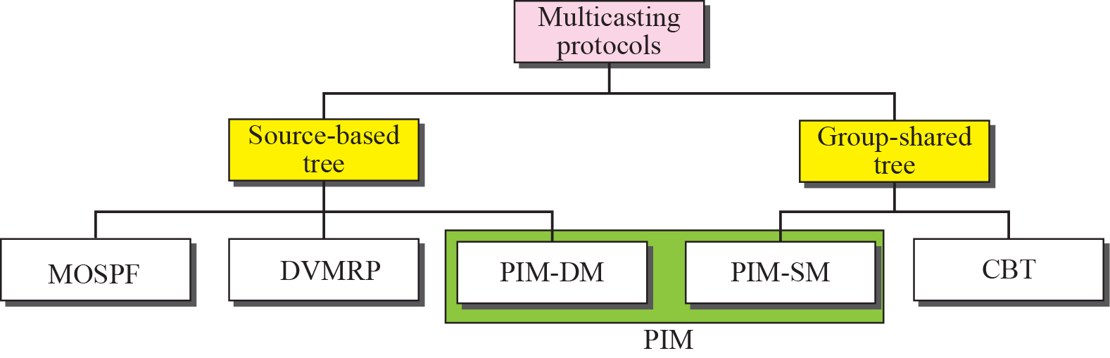
Taxonomy of common multicast protocols

Slide 3
Multicast link state routing uses the source based tree approach

Slide 4
MOSPF(1)
Group membership LSA is flooded throughout the AS
The router calculates the shortest path trees on demand (when it receives the first multicast packet)
MOSPF is a data-driven protocol; the first time an MOSPF router see a datagram with a given source and group address, the router constructs the Dijkstra shortest path tree

Slide 5
MOSPF(2)
The shortest path tree is made all at once instead of gradually (i.e. pre-made, pre-pruned, ready to use)

Slide 6
MOSPF with Areas (1)
Group management
Group-membership LSA is flooded in the same area.
Inter-area multicast forwarders (area border routers) summarize their attached areas' group membership to the backbone.
Data routing
Introduction of the wild-card multicast receivers (area border routers)

Slide 7
MOSPF with Areas(2)
Data routing (cont)
In the presence of OSPF areas, during tree pruning care must be taken so that the branches leading to other areas remain, since it is unknown whether there are group members in these (remote) areas.
For this reason, only those branches having no group members nor wild-card multicast receivers are pruned when producing the datagram shortest-path tree.

Slide 8
MOSPF with Areas(3)
Data routing (cont)
1. Source area: building intra-area shortest path tree (forward cost) with leaf nodes including wild-card multicast receivers.
2. Backbone area: each wild-card multicast receiver of the source area calculates the shortest path from the source to the multicast forwarders (with group members) of other areas using the reverse cost.
(You must know the reason why using the reverse cost in this case)

Slide 9
MOSPF with Areas(4)
Data routing (cont)
E.g. In Figure 4 of the sample MOSPF area configuration in the supplementary document, RT3 and RT4 can calculate and compare to determine which one of them should construct the shortest path from the source to RT7, RT10, and RT11 (the multicast forwarders in non-source areas). The result tree is shown in Figure 9 in the supplementary document.

Slide 10
MOSPF with Areas(5)
Data routing (cont)
3. Destination areas: The corresponding multicast forwarder (e.g. RT7 in area 2) constructs the shortest path using the reverse cost to each network (with group members) in its own area.

Slide 11
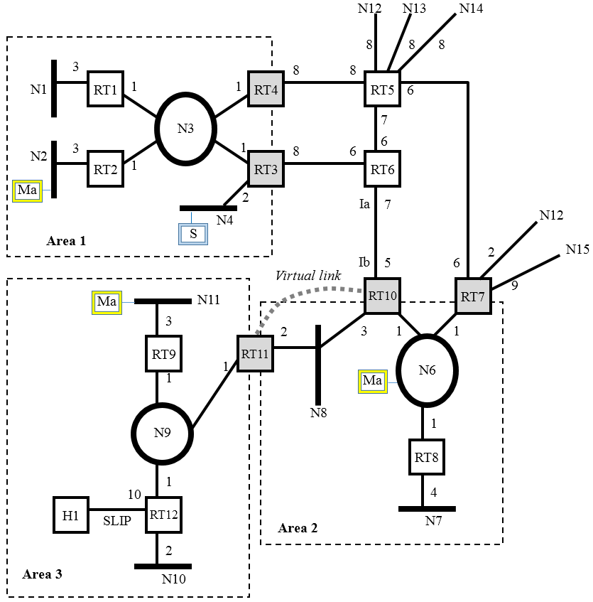

Slide 12
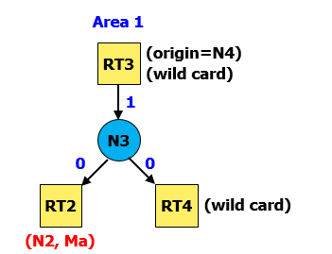
MOSPF Tree in Source Area

Slide 13
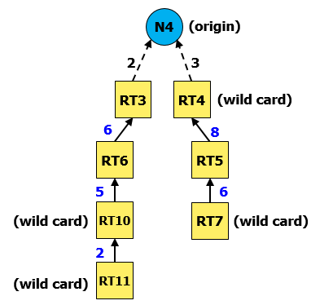
MOSPF Tree in Backbone Area

Slide 14
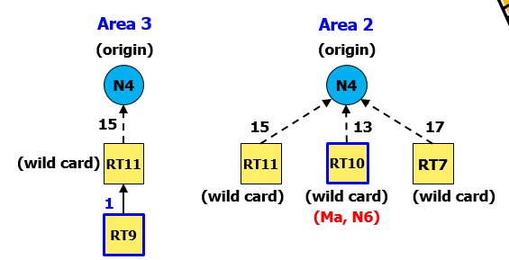
MOSPF Tree in Destination Area

Slide 15
Protocol Independent Multicast (PIM)
To develop a scalable protocol independent of any particular unicast protocol
ANY unicast protocol to provide routing table
A router can switch between DM and SM depending on the group

Slide 16
PIM Dense Mode
Deployed in resource rich environments
RPM Algorithm
Similar to DVMRP
Algorithm
A datagram is forwarded if the arriving interface is the shortest path back to the source
Datagram forwarded on all outgoing interfaces initially
Create forwarding cache entry
Prune and graft messages used to prune the tree

Slide 17
Leaf Network Detection
Absence of PIM Hello messages
No host membership reports
Pruning on a Multi-access LAN
A prune is sent upstream when the outgoing interface list is empty
Upstream router schedules the interface for deletion (Delay 3 sec)
Any other routers on the LAN that depend on the upstream router send a PIM-Join
Deletion request of interface cancelled
Randomly delay Join message to reduce traffic
Prunes are flushed periodically

Slide 18
Graft and Graft ACKs
Designated Router in Multi-access LANs
Highest IP address router as seen in “Hello”
Assert Messages
When duplicate packets arrive on a multi-access LAN
Send Assert with metric for that source
Choose router with lower metric
Equal metrics, higher IP address prevails
Modify upstream and downstream neighbors

Slide 19
Sparse - Mode
PIM-SM, CBT
Assumptions
group members are sparsely distributed throughout the network
BW not widely available
Receiver initiated construction of the spanning tree
Limit multicast traffic and hence improve scalability
Define a Rendezvous Point (RP) and build the multicast tree around it

Slide 20
Algorithm
Sender sends data to the RP
Receivers JOIN the RP tree
Difference from DM
Receiver initiated vs Data Driven
SM routers maintain state info ( Primary RP)
Advantages
Conserve network resources
Decreased amount of info in routers
Disadvantages
Concentration of traffic around RP
Sub-optimal trees increase Latency

Slide 21
PIM Sparse Mode
Independent of particular unicast routing protocol
Algorithm
Senders send data to the RP
Receivers JOIN the tree
Unwanted branches pruned
Receivers can switch trees
S1
S2
Rendezvous
Point
Rendezvous
Point
R
R
R
R
R
R
R

Slide 22
Designated Router
Multiple routers on a LAN : Highest IP address
Responsibilities
IGMP Queries
JOIN/Prune messages towards RP
Maintain status of active RP
Route Entry
Source address, Group Address
Incoming interface (towards RP)
Outgoing interfaces (towards receivers)
WC-bit: Any source would match (*,G)
RPT-bit: Join sent up the shared RP tree

Slide 23
Receivers : when a new host report received
Look up primary RP for that group
Unicast JOIN message to the RP
Payload: Address G, Join = RP, WC_bit, RPT_bit, PRUNE = NULL
Create forwarding route entry for (*,G) pair
Delete cache entry when no more members
Intermediate routers transmit JOIN to RP
Create forwarding route
entry for (*,G)
Source (S)
Designated
Router
Rendezvous Point
(RP)
for group G
Host
(receiver)
Join
Join

Slide 24
Hosts sending to Group
Its DR looks up the active RP for that group
Unicast data, encapsulated in a PIM-SM-Register to the RP
Active RP sends a PIM-Join to the source DR
Intermediate routers maintain state info (*,G)
When source gets a Join, it sends further packets without encapsulation
RP resends all data on the shared tree
Source (S)
PIM Router
Rendezvous Point
DR
PIM-Register
PIM-Join
Resend to Group members
Host
(receiver)
Host
(receiver)
RP

Slide 25
If data rate warrants an SPT, an (S,G) state created
RP sends periodic Join/Prune to the source
Intermediate routers maintain (S,G) state info
Sources stop encapsulating data when they receive Register-Stop messages
RP has no downstream members for that group or source
RP already receives native data from (S,G) tree
Switching from RP-Shared tree to SPT
Depending on the data rate of a particular source, a switch over may be initiated
Only by RP or routers with members
Activate (S,G) route entry

Slide 26
JOIN/PRUNE message from the rx towards the source
Payload: Address G, Join = S, Prune = NULL
Prune towards the RP for that (S,G)
Steady state of distribution tree
Each router periodically sends JOIN/PRUNE for each active route entry
To the neighbor indicated in the route entry
Helps capture changes in topology/state/membership
Source (S)
RP Tree
SP Tree
Host
(receiver)
DR
RP

Slide 27
RP Information
Bootstrap messages are used to distribute RP information within the domain
Domains’ Bootstrap Router (BSR) elected from set of candidates
A set of RP candidates periodically advertise to the BSR the groups associated with them
C-RP-Advertisements: Address of C-RP, Group address and mask
C-RP-Advs distributed in BS messages
The Advs are used by DRs
use a Hash function to map a group address to one C-RP whose ad includes the group

